Slide 1
POWER BI | BUSINESS ANALYTICS PROJECT
HR ANALYTICS
DASHBOARD
Employee Attrition, Workforce & Compensation Analysis
PROJECT PRESENTATION
HR Analytics Dashboard Project
MOHD ASAD ANSARI
BBA • 3rd Semester
Academic Project • October 2026
01

Slide 2
Project Overview
A visual analysis of workforce patterns using the Power BI dashboard.
Project aim
TOOLS & OUTPUT
• Explore employee attrition and compare employees marked Yes and No.
Microsoft Power BI
• Review hourly and monthly rate measures and compensation differences across job roles.
Interactive dashboard
KPI cards • charts • visual comparisons
• Understand workforce distribution by department and gender.
• Explore the relationship between years at company, age and employee retention.
Focus
People analytics and
evidence-based HR decisions
• Present the key information in one dashboard for quick review and discussion.
02

Slide 3
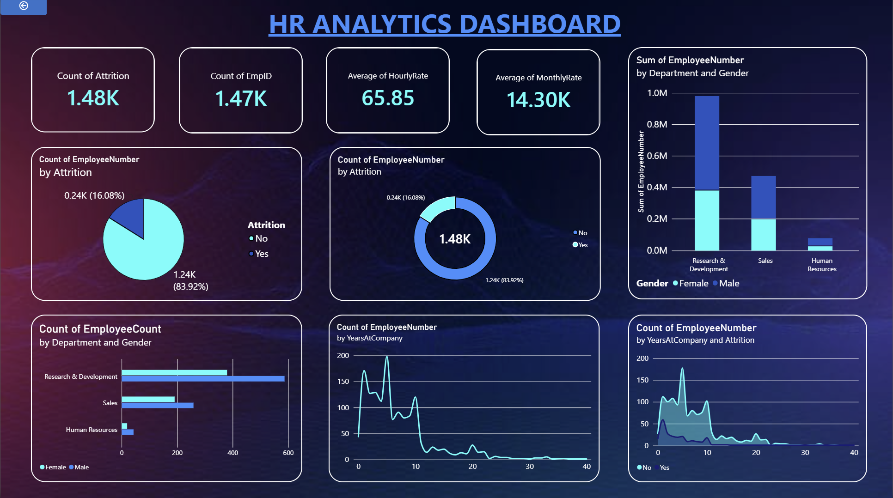
Dashboard Snapshot
Power BI dashboard layout recreated from the supplied PBIX.
Dashboard snapshot taken directly from the Power BI dashboard supplied for this project.
03

Slide 4
Dashboard Components
Each visual answers a different HR question.
KPI cards
Attrition chart
Monthly income by job role
Quick view of employee count, attrition and rate
measures.
Compares employees marked Yes vs No for
attrition.
Highlights the compensation hierarchy across
roles.
Department by gender
Years at company
Age & salary cuts
Shows workforce distribution by department and
gender.
Shows how workforce/attrition changes with
tenure.
Adds context on where attrition is concentrated.
04

Slide 5
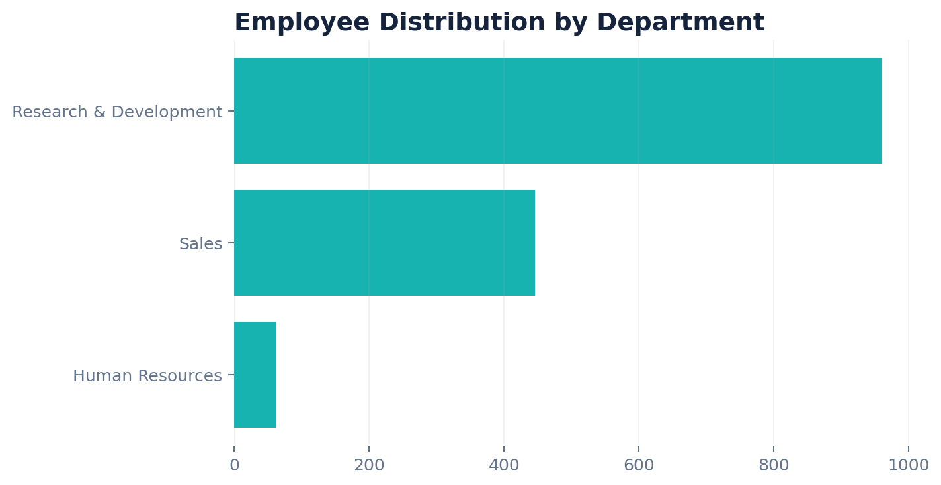
Workforce Overview
The dashboard gives a compact view of workforce scale and composition.
1,470
237
65.89
14.3K
Total employees
Employees with attrition = Yes
Average hourly rate
Average monthly rate
What stands out
• Research & Development contains the majority of employees (961).
• Sales is the second-largest workforce group (446).
• Human Resources is a small specialist function (63).
• The workforce is 60% male and 40% female.
05

Slide 6
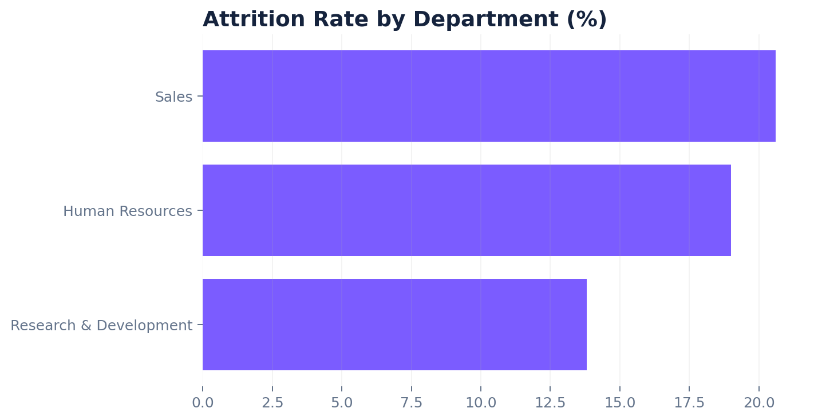
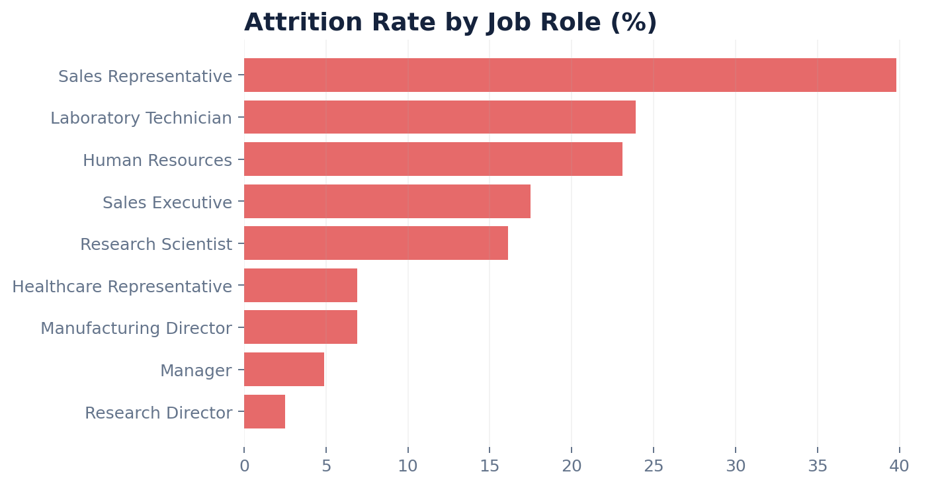
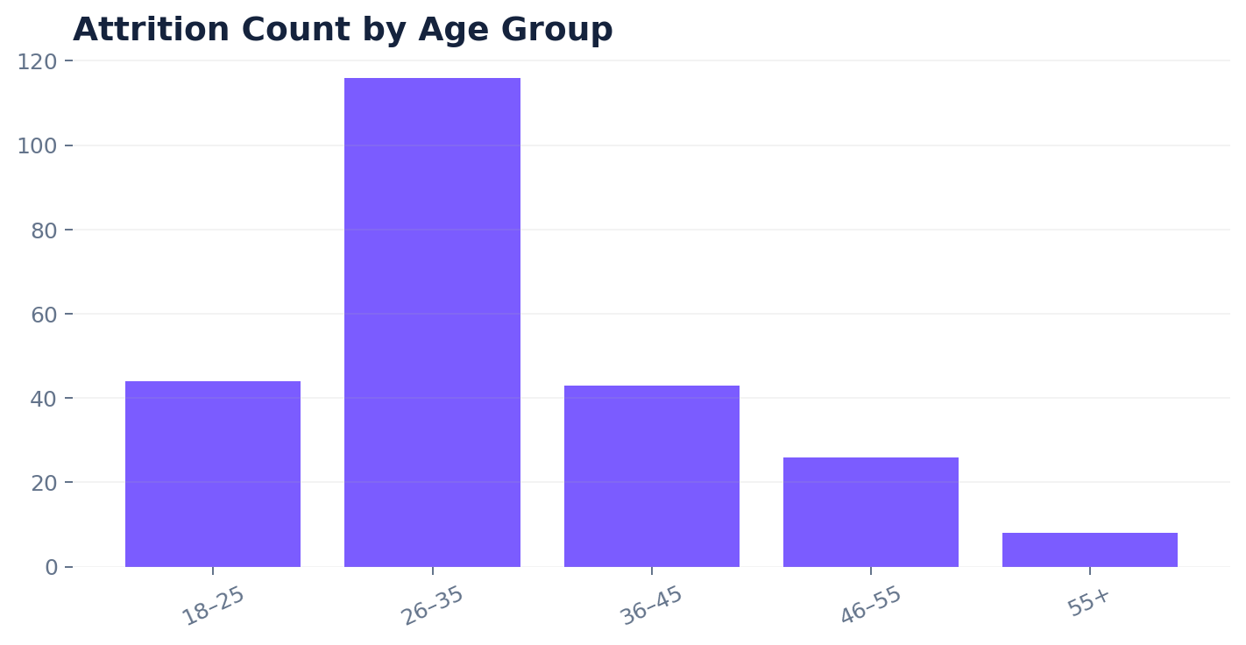
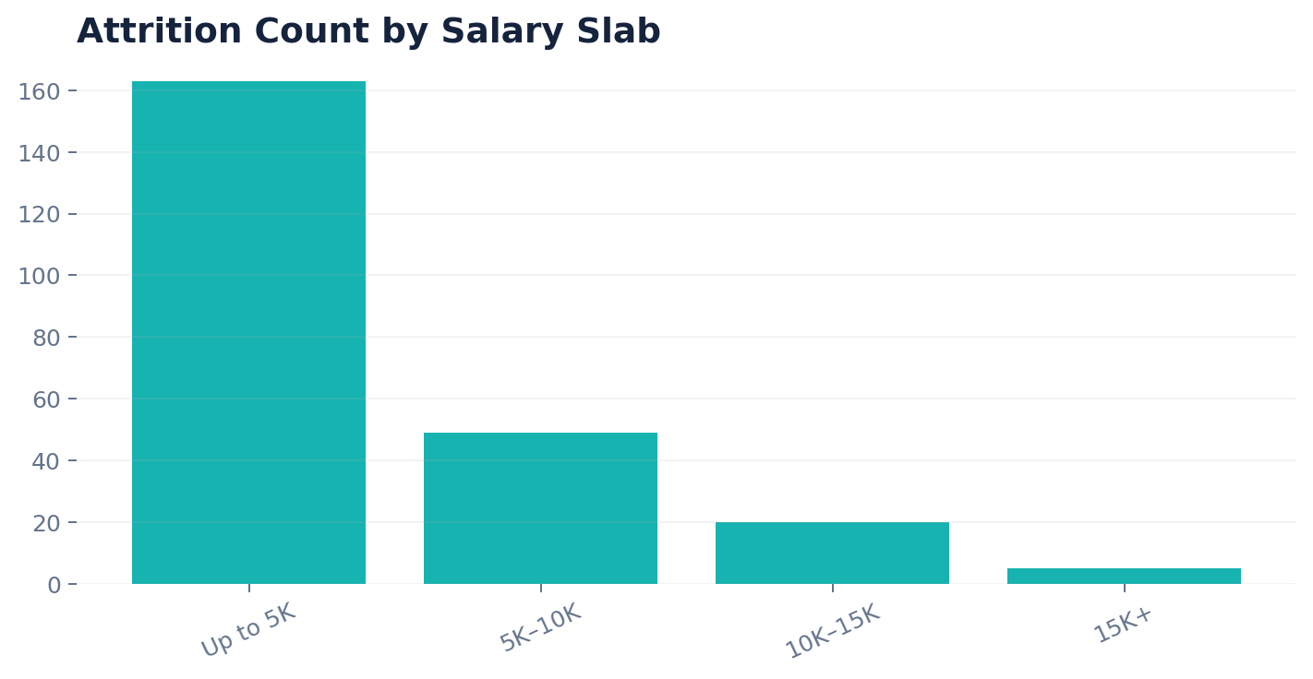
Attrition Analysis
Attrition is concentrated in specific departments, roles and employee segments.
06

Slide 7
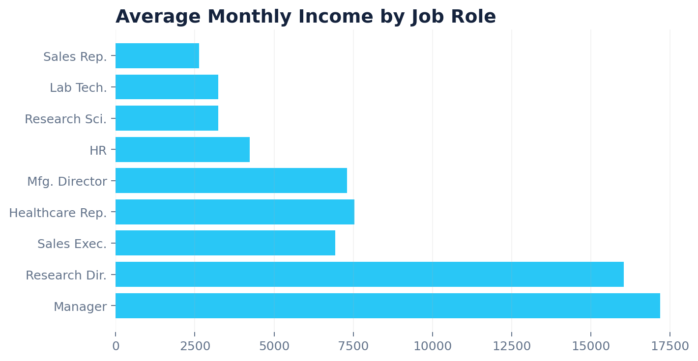
Compensation Analysis
Income varies sharply by role, making compensation an important retention lens.
Key observations
• Managers and Research Directors sit at the top of the
salary hierarchy.
• Sales Representatives, Laboratory Technicians and
Research Scientists have the lowest average monthly income.
• The dashboard’s rate cards provide a quick benchmark
before drilling into job roles.
• Compensation should be reviewed alongside tenure and
attrition rather than in isolation.
07

Slide 8
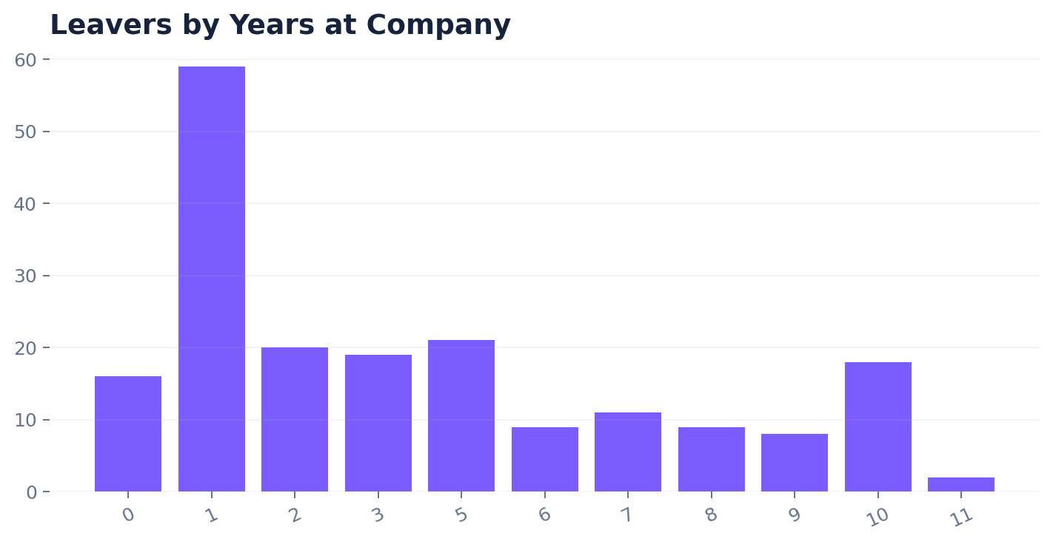
Tenure & Retention
Early tenure is a critical zone for monitoring employee exits.
What the pattern suggests
• The highest visible attrition count occurs around the first
few years at the company.
• Attrition falls as tenure increases, with smaller counts
among longer-tenured employees.
• Retention programs should focus on onboarding, career
growth and manager support early in the employee lifecycle.
• Tenure should be interpreted together with role, age and
compensation.
08

Slide 9
HR Recommendations
Translate the dashboard patterns into practical HR actions.
01
Monitor attrition
Track the number and percentage of employees leaving by department, role and tenure.
02
Review compensation
Compare pay within similar roles and investigate unusual gaps or low-pay/high-attrition segments.
03
Strengthen early-tenure retention
Use onboarding check-ins, manager support and career-development conversations during the first few years.
04
Use dashboard filters consistently
Validate measures, aggregation and filter context before presenting a KPI as a business decision.
09

Slide 10
CONCLUSION
Turning HR data into
clearer decisions
PROJECT BY
HR Analytics
Project
The Power BI dashboard brings workforce size, attrition, compensation, department structure
and tenure into one visual workspace. The strongest value comes from combining the KPI view
with role, department and tenure-level patterns.
BBA • 3rd Semester
Key takeaway
Academic Project
October 2026
Use the dashboard to identify where retention attention is needed —
then validate the underlying measure before acting.
Thank You
10

